Slide 1
HEALTH INSURANCE MARKET
Instructor: Dr. Jongwook Woo
Group – 2
Ayushi Porwal
Zalak Patel
Kajal Bhandare
Clifford Lin

Slide 2
Agenda
Introduction
Cluster Specification
Project Workflow
Table Creation
Analysis & Visualization
Challenges / Solutions
Dataset Details
Conclusion

Slide 3
Introduction
The Health Insurance Marketplace Public Use Files contain data on health and dental plans offered to individuals and small businesses through the US Health Insurance Marketplace.
Project Analysis:
Analyzed plan rates across different years & number of dependents.
Conducted analysis for identifying which plan type is popular & which company’s plans are best sellers?
What types of plans are offered across state and how many insurance network providers are there for each plan type?
Analyzed different plan benefits across different states & years.

Slide 4
GitHub URL
https://github.com/ayushiporwal13/HealthInsuranceAnalysis

Slide 5
Dataset Details
DATASET NAME: Health Insurance Marketplace Dataset
DATASET URL: https://www.kaggle.com/datasets/hhs/health-insurance-marketplace/data
SIZE: 3.15GB
NUMBER OF FILES: 4
FORMAT: CSV
COUNTRY CONSIDERED: USA

Slide 6

Hadoop Cluster Specification
CLUSTER VERSION:​ ​Hadoop 3.1.2
CLUSTER NODES:​ 5 (2 master nodes & 3 data nodes)
MEMORY SIZE:​ Memory Used – 367.68 GB, Memory Remaining – 20.96 GB
CPU SPEED:​ ​1995.312 MHz

Slide 7






Project Architecture
Data Source
Analysis Preparation
Validation & Analysis
Analysis Download
Visualization

Slide 8
Project Workflow
Sourcing
- Health Insurance Marketplace Data Set
Preparation
- Upload with scp
- Unzip
- Mkdir
Validation & Analysis
- Table
- Queries
Download
-scp
Visualization
- Tableau & Excel

Slide 9

Table Creation

Slide 10
Data Queries
ØTemporal Analysis
Average plan cost per person across year
Top Network providers across year
Top 5 benefits sold for different year
ØSpatial Analysis
Highest enrollment rate across state
Different plan types offered across state
Benefits changes across state
ØAdditional Analysis
Total unique network provider across plan type

Slide 11
Creating Multiple Tables
Create external table from data set
Using the SERDE function will create a table with all data types defaulted to the STRING data type
ROW FORMAT SERDE
'org.apache.hadoop.hive.serde2.OpenCSVSerde'
WITH SERDEPROPERTIES ('separatorChar' = ',',
'quoteChar' = '"', 'escapeChar' = '\\' )
Create another table from new table created
Using the cast function, the data can be translated into the desired data type

Slide 12
Table Column Information
Column Name | Data Type | Column Name | Data Type
Business Year | Int | Couple Dependent | Decimal
Benefit Name | String | Plan ID | String
State Code | String | Issuer ID | Int
Individual | Decimal | Network URL | String
Couple | Decimal | Market Coverage | String
Dependent | Decimal | Network ID | String
Dependent 2 | Decimal | Network name | String
Dependent 3 | Decimal | Plan Marketing Name | String
Couple Dependent 2 | Decimal | Plan Type | String
Couple Dependent 3 | Decimal | Dental Only Plan | String
Disease Management Programs Offered | String

Slide 13
Exploratory/Descriptive Analysis

Slide 14
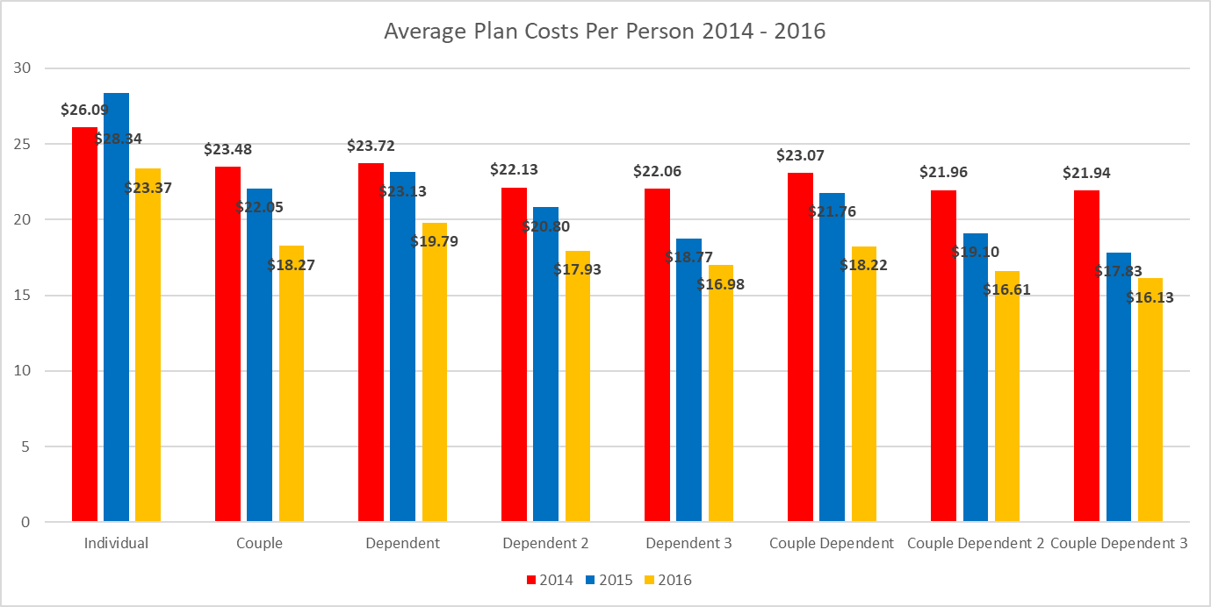
Average Plan Cost Per Person 2014-2016
Adding dependents as an individual or couple drastically decreases cost per person
Prices for all categories decrease over the three years
Interestingly, it is more costly as an individual with a dependent than as just a couple

Slide 15
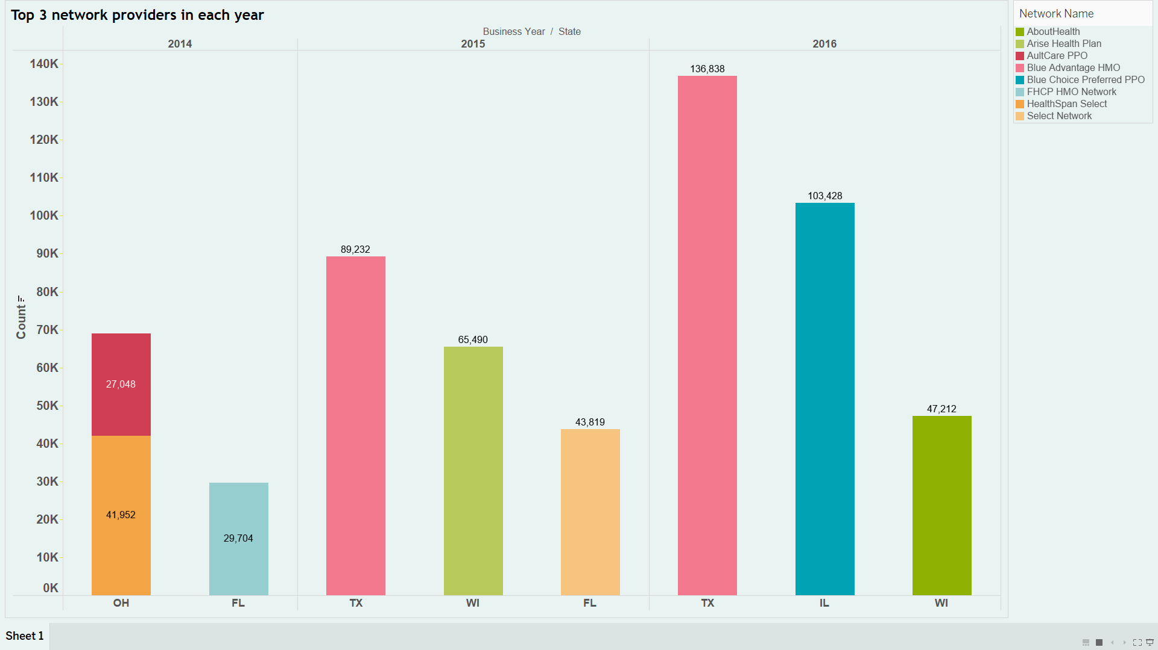
Leading Network Providers in each Year with Highest Enrollment Rate Across States
The graph represents leading network providers in USA for the years 2014, 2015, and 2016.
Blue Advantage HMO stayed on top for two consecutive years in Texas.
Arise HealthPlan ranked among the top three in Wisconsin in 2015, while AboutHealth took the lead in 2016.

Slide 16
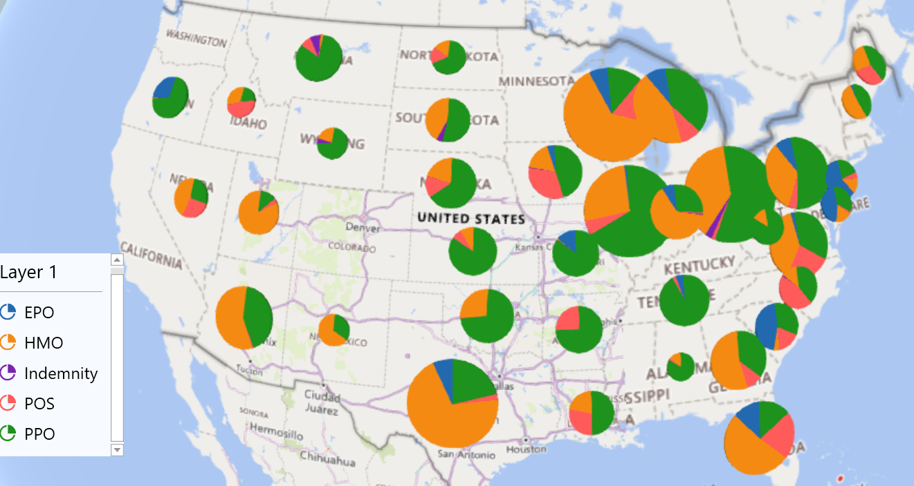
Plan Types Across States
Highest number of EPO plan types offered in South Carolina state.
The Most HMO and POS plans are offered in Wisconsin state.
In Ohio state, highest number of Indemnity and PPO plans are offered.

Slide 17
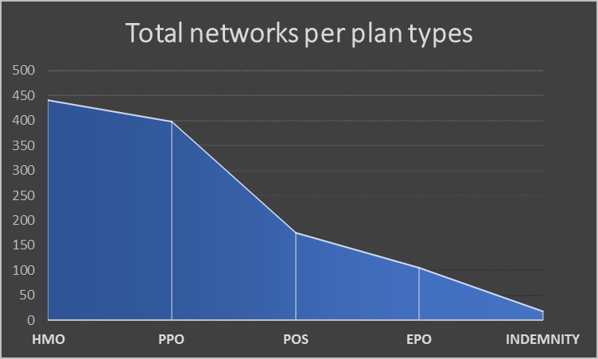
Total Networks Across Plan Type
HMO plan has highest number of network providers with 443 total unique network count.
Followed by PPO with 400 network provider and POS plan type with 177 network provider.
EPO plan type has 107 network provider
Indemnity plan type has the lowest network with only 20 count

Slide 18
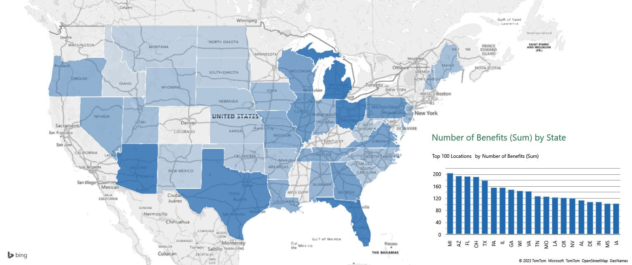
Benefits Changes Across States
The highest number of Benefits are provided in the state of Michigan with 205 different benefits plan.
Followed by Arizona with 195 benefit plan.
Florida is the third state with 194 benefits plan.
Idaho is the state with the lowest benefits plan offered - only 71!

Slide 19
Top 5 Benefits Sold for Different Years
The top sellers among the 3 years, the highest number of benefits were sold in 2015
Orthodontia - Adult is the most sold benefit for all the years.
The growth from 2014 to 2015 and the decline from 2015 to 2016 remains consistent except the benefit Orthodontia – Child.

Slide 20
Challenges & Solutions
Challenges | Solutions
Difficulty in handling commas in cell content while uploading CSV file | To overcome this, we used "Serializer and Deserializer"(SerDe ) properties to initially separate the CSV file
Understanding the data | Identified patterns, trends, and relationships
Unable to download csv files from kaggle directly using wget as we did in lab. | Download dataset on local system. Use 'scp' command to upload on Linux server and then move to Hadoop

Slide 21
Conclusion
Adding dependents as an individual or couple drastically decreases the cost per person
Among the top benefits sold, all benefits are dental benefits
Blue Advantage HMO is popular network provider, among others.
Among all the plans offered, HMO is the most popular one.

Slide 22

Questions ?

Slide 23


